Slide 1
Neighborhood Battle Of Four Cities
Vijay Oommen
COURSERA DATA SCIENCE CAPSTONE

Slide 2
Introduction
Human migration is the movement by people from one place to another with the intentions of settling, permanently or temporarily in a new location. Early human migrants are usually result of climate change. Though the climate change is no longer severer in modern societies, there are still a number of causes impel migrants to move to another country. Globalization is one of the reasons people move to new places for better job opportunities
Migration is a huge event for most migrants. In addition to searching for new accommodation and new job, migrates also need to overcome culture shocks during settle down. In order to have a smooth transfer in the new city, it is very desirable to move to a similar neighborhood as where migrants live before. For example, a coffee lover who usually needs a cup of coffee every morning from Starbucks will prefer a place with a cafe nearby. I would like to use the Foursquare location data to analyze the neighborhoods of four different cities New York, Toronto, Beijing and Shanghai. These cities are the economic or political center of the countries. I wish to find similar neighborhoods among these cities and provide some useful information for people who are considering moving among Canada, USA and China.

Slide 3
Data
The neighborhood data of New York is provided here: https://geo.nyu.edu/catalog/nyu_2451_34572
The neighborhoods of Toronto are extracted from
here: https://en.wikipedia.org/wiki/List_of_postal_codes_of_Canada:_M
The neighborhoods of Beijing are extracted from
Wikipedia: https://en.wikipedia.org/wiki/List_of_township-level_divisions_of_Beijing
The neighborhoods of Shanghai are from: https://en.wikipedia.org/wiki/List_of_township- level_divisions_of_Shanghai
Please note all my data and analysis are available in my GitHub page:
https://github.com/vjoommen/Coursera_Capstone/blob/master/Capstone_Project.ipynb

Slide 4
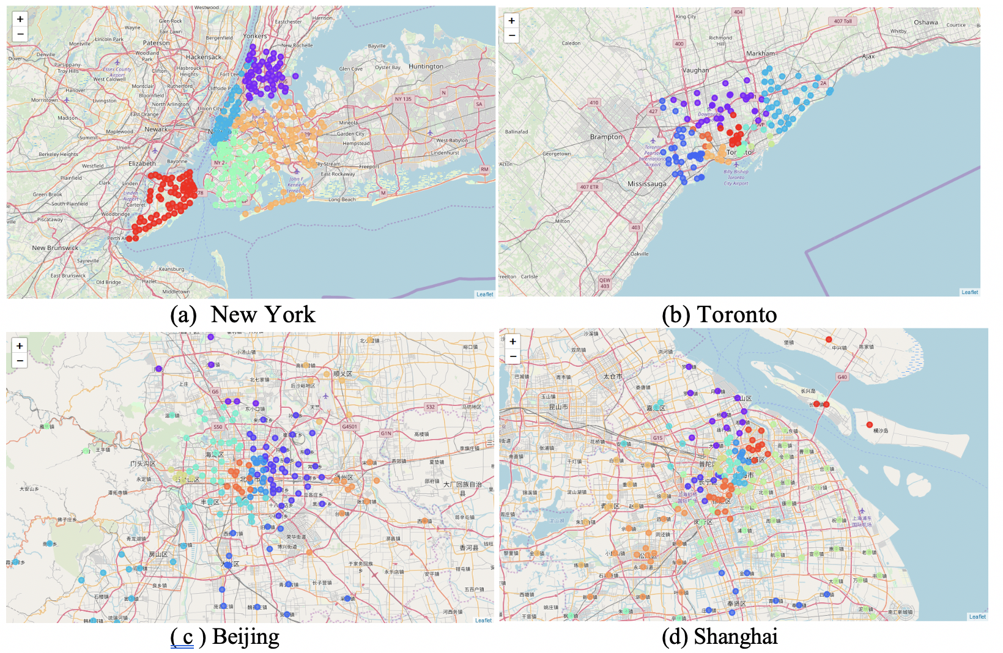
Methodology
Data preparation
The New York data is available online with the neighborhood name and location information (latitude and longitude). For Toronto, Beijing and Shanghai, only neighborhood name is provided, I used the Nominatim library to obtain the location information by searching each neighborhood name.
For those neighborhoods within the same borough, they were shown on map with the same label color.

Slide 5
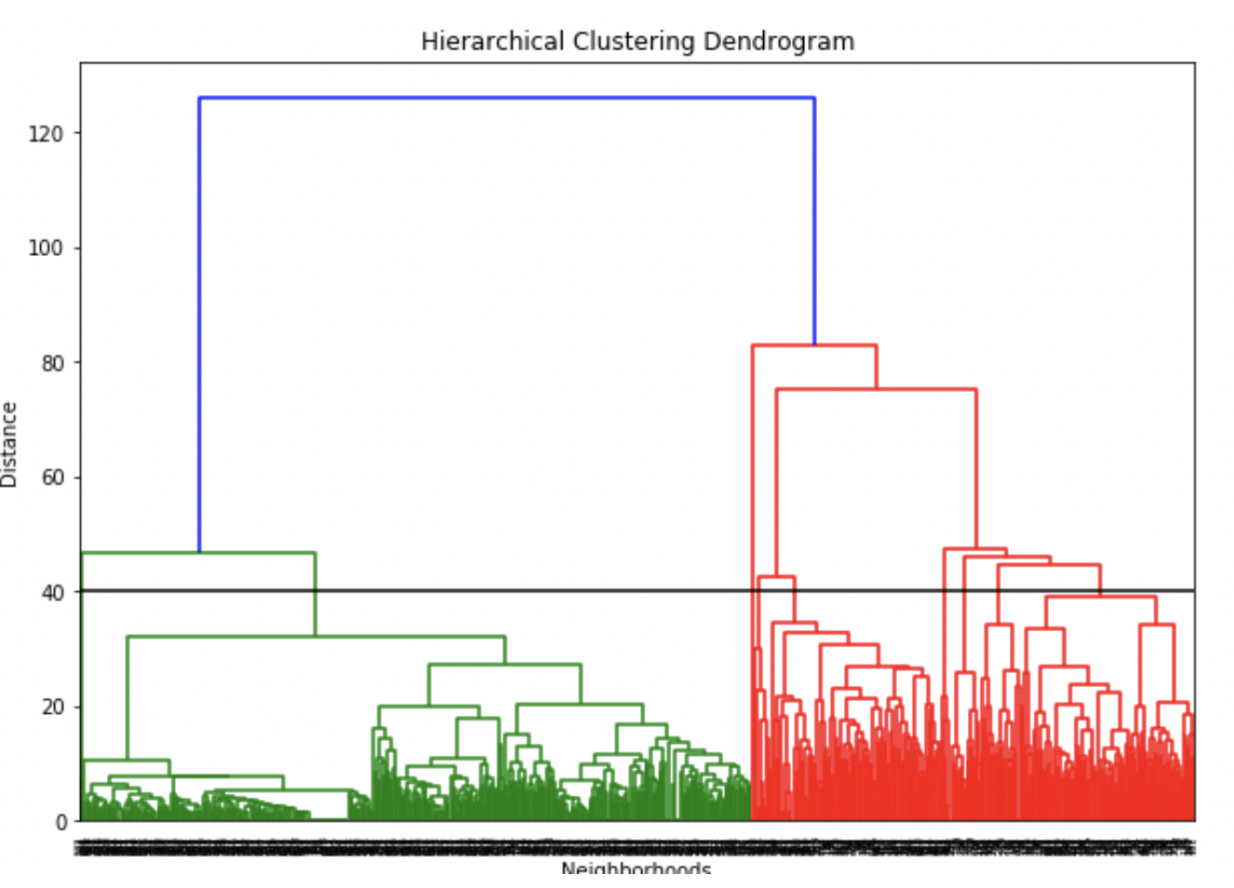
Methodology
Data acquisition
Foursquare API for exploring and acquiring nearby venues.
Data Analysis
Hierarchical agglomerative clustering method to compare neighborhoods among cities

Slide 6
Results
Total number of neighborhoods in each cluster
Cluster | 0 | 1 | 2 | 3 | 4 | 5 | 6 | 7 | 8
Total number of neighborhoods | 122 | 121 | 21 | 31 | 8 | 2 | 2 | 478 | 13

Slide 7
Results
Cluster 0 contains the neighborhoods in New York and Toronto. The New York region consists a wide range of local business like restaurants and pizza shops. As for Toronto, the neighborhood primarily constitutes shopping centers.
Cluster 1 is basically the city center where surrounded by a variety of venues, including theaters, parks, restaurants and bars.
Cluster 2: Neighborhoods in New York with a lot of nearby pizza places, fast food restaurants and Caribbean restaurants.
Cluster 3: Most are New York and Toronto neighborhoods with a lot of Italian and pizza places
Cluster 4 includes the neighborhoods in New York, Toronto and Beijing. These neighborhoods have a lot of dining place with Korean cuisine.
Cluster 5 and 6 contains only 2 hence considered as outliers.
Cluster 7 is basically the city center where surrounded by a variety of venues, including theaters, parks, restaurants and bars.
Cluster 8 contains primarily Downtown Toronto neighborhoods with access to various venues like restaurants and shopping centers

Slide 8
Conclusion
For those who have a job in the city center and don’t want to spend much time on transportation, neighborhoods in Cluster 1 will be good.
Cluster 7 neighborhoods looks to be the ideal locations for residential living condition since it provides good balance to key venue categories like park, department stores, restaurants and access to public transportation. These neighborhoods are not crowded as city centers, but has a number of outdoor parks, restaurants and supermarkets.

